Slide 1
Designing an aircraft tracking datastore
A Small Big Data (and IoT) project

Slide 2
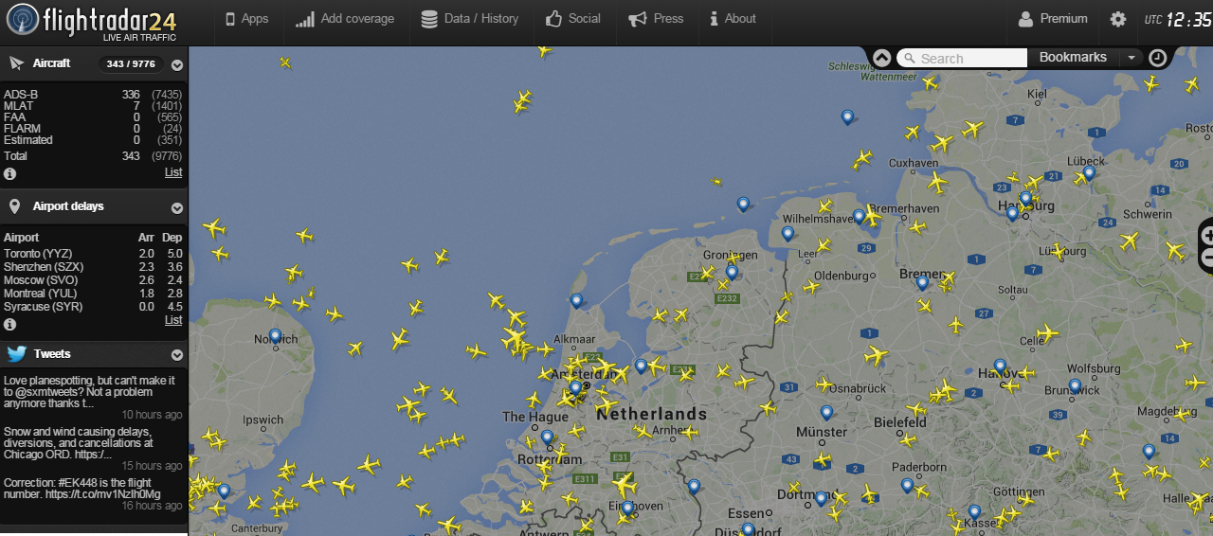
Starting point
Sites like flightradar24.com show the live position and heading of every commercial aircraft in a region. How cool is that?

Slide 3
Data format
Each aircraft transmits its position and identity data continuously at 1090 MHz
Sparse data sets containing flight number, position, heading, speed, height – but not all fields are populated in every record

Slide 4
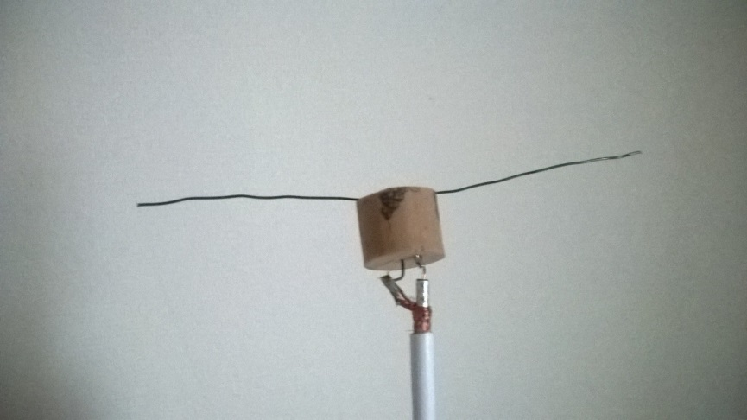
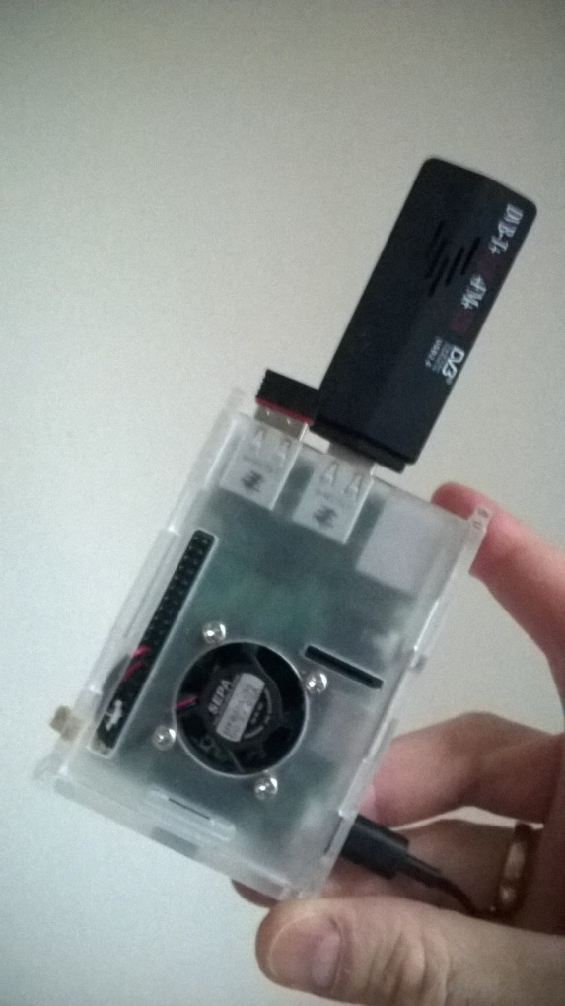
Data collection
Antenna
… and receiver

Slide 5
Data Flow
Source (Receiver)
Kafka topic
Deduplicate rows
Source (Receiver)
Coalesce / complete data rows
Group records
Realtime feed
Evaluation
Live map/API
Reports/History

Slide 6

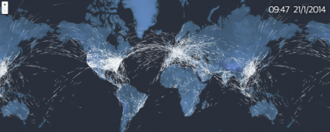
Architecture (logical)
dump1090
Kafka producer
Kafka Broker
HBase
Kafka consumer
Kafka Broker
HDFS
Kafka Broker
dump1090
Zookeeper
Spark
Kafka producer

Slide 7
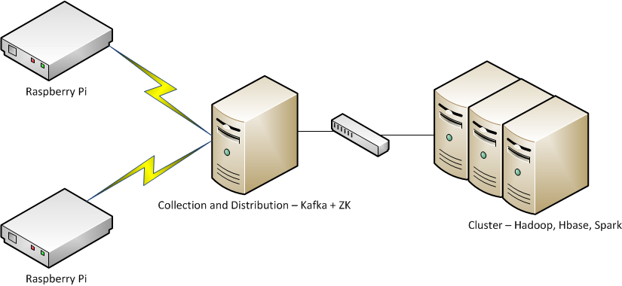
Architecture (physical)

